Slide 1


Majors
CUDAP Sign Choir, 2/7/18

Slide 2
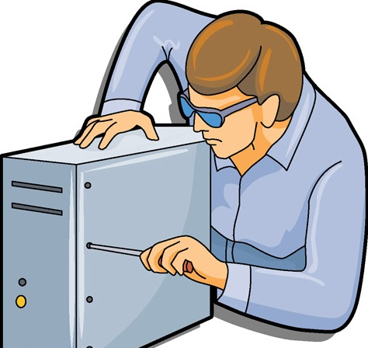
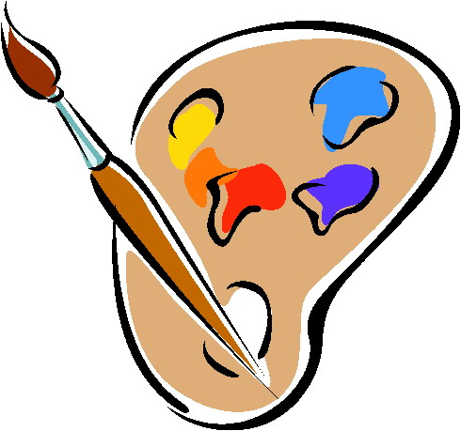
Word List
Agriculture
Animal science
Art
Biology
Chemistry
Computer science
Economics
Engineering
English
Environmental science
Food science
History
Hotel administration
Government
Law
Linguistics
Math
Music
Physics
Pre-med
Psychology

Slide 3
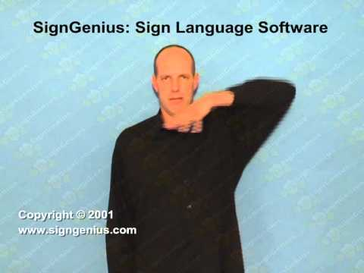
Agriculture
Description: Open-5 handshape, thumb by your left ear, move to other ear

Slide 4
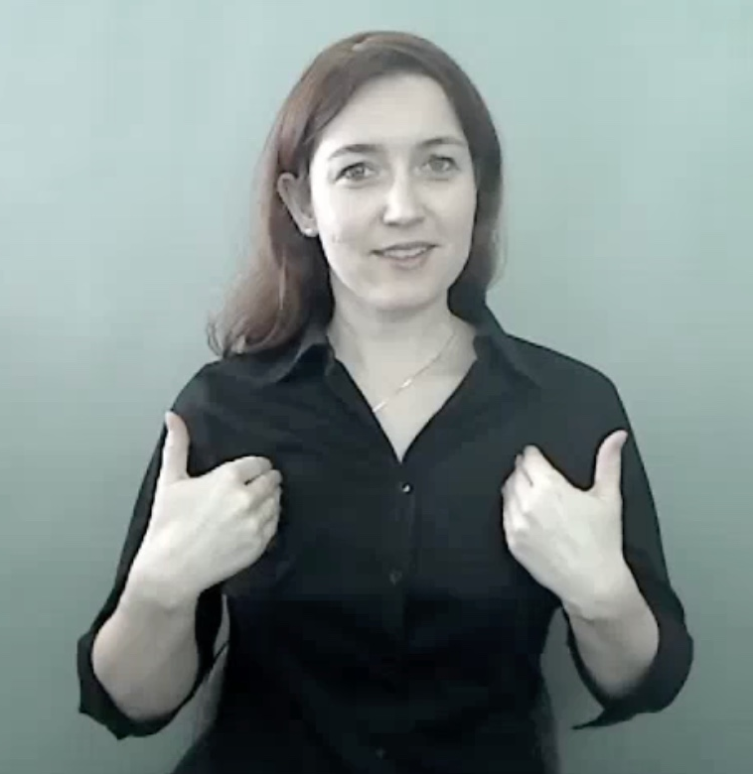
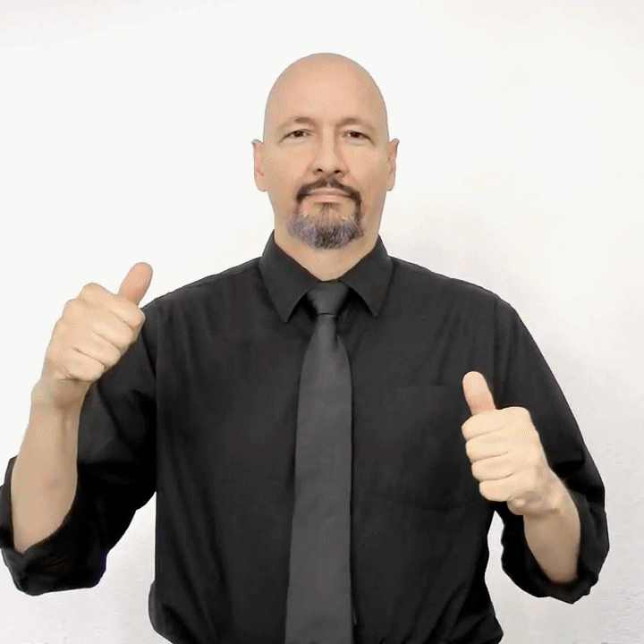
Animal Science
Animal: move your wrists towards your chest twice
Science: make circles with your hands (like you’re pouring chemicals)

Slide 5
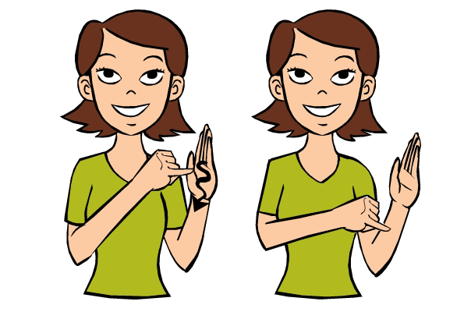
Art
Description: draw a squiggle on your palm with your pinky finger

Slide 6
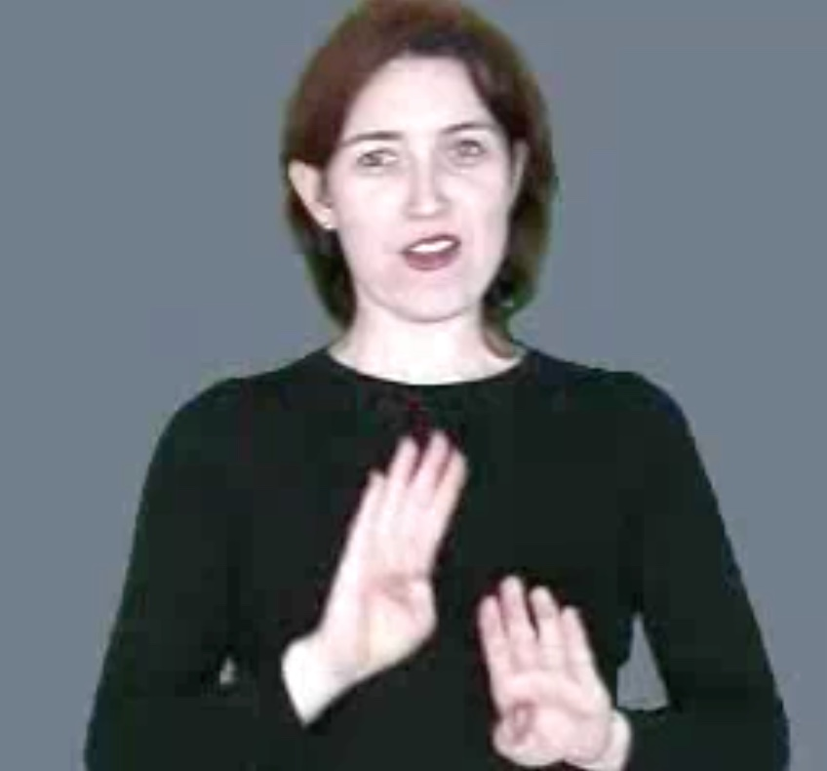
Biology
Description: move two B-handshapes in circles (like the sign for science)

Slide 7
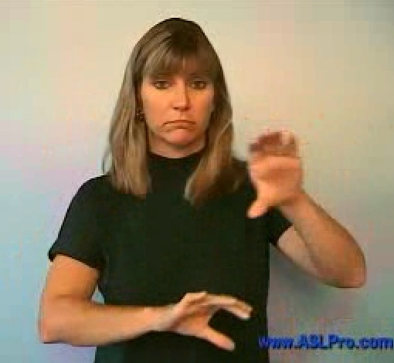
Chemistry
Description: move two C-handshapes in circles

Slide 8
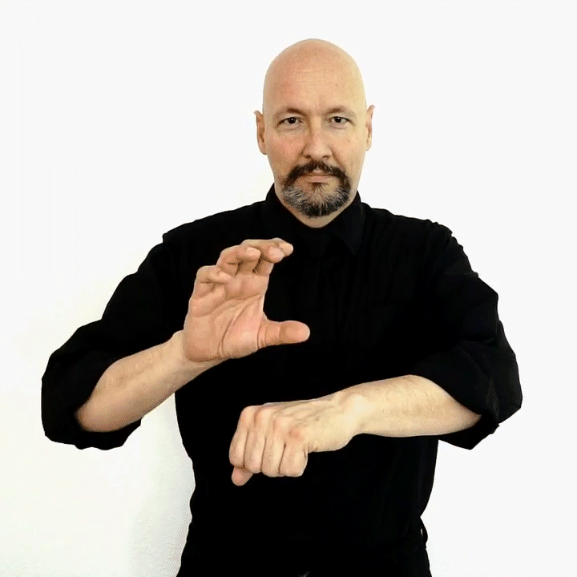
Computer Science
Description: move a C-handshape in a circle over your left arm

Slide 9
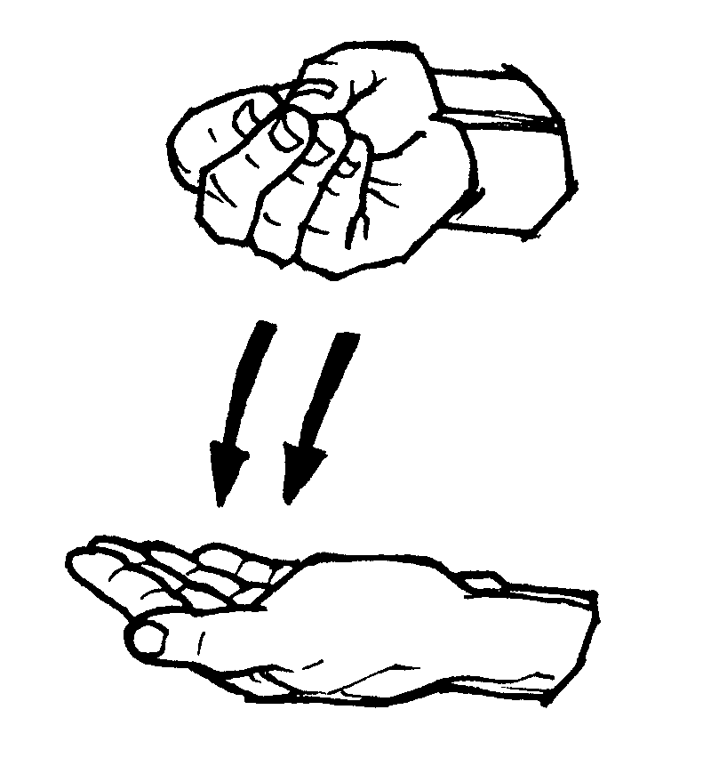
Economics
Description: move an E-handshape onto your open palm

Slide 10
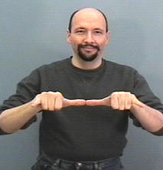
Engineering
Description: thumbs and pinkies extended on both hands, thumbs touching, bend right hand down twice

Slide 11
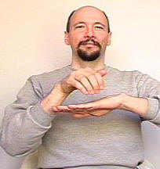
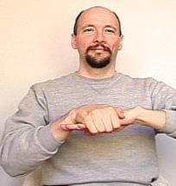
English
Description: grab your left hand with your right and move them forward (like someone is guiding your hand)

Slide 12
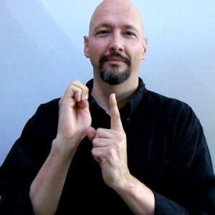
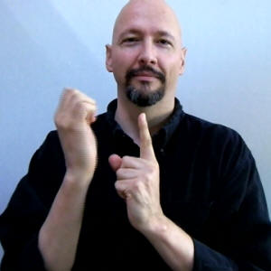
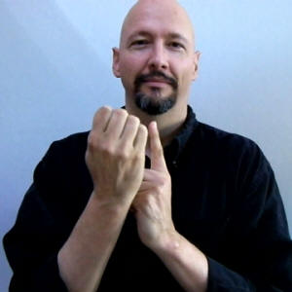
Environmental Science
Description: Move an E-handshape around your left index finger + “science”

Slide 13
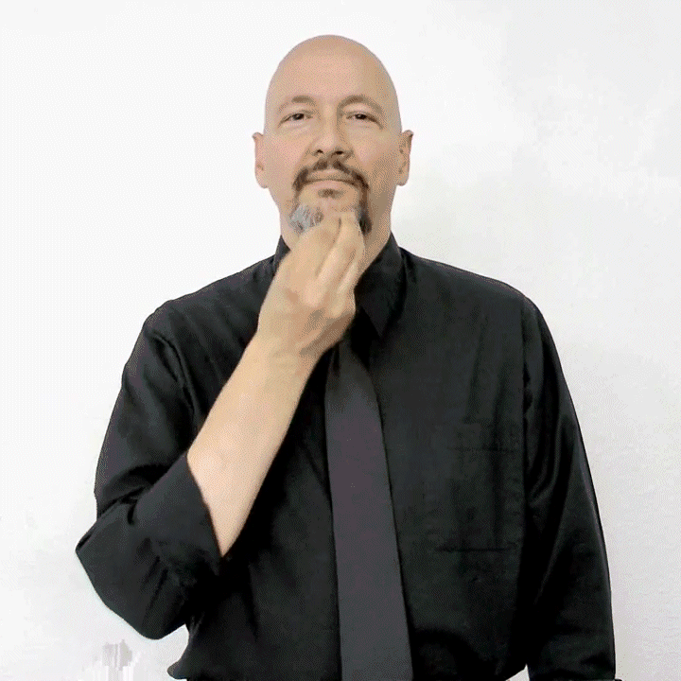
Food Science
Description: tap your fingers against your mouth twice + “science”

Slide 14
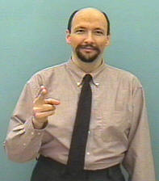
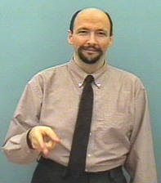
History
Description: move an H-handshape down, up, and then down again

Slide 15
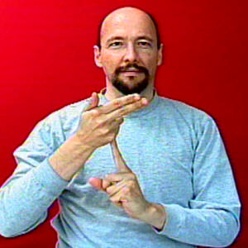



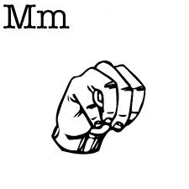
Hotel Administration
Description: left index finger up, wave your right fingers like a flag, then fingerspell “A-D-M”

Slide 16
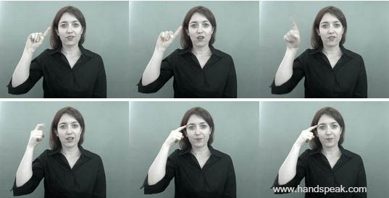
Government
Description: make a circle with your index finger while bending it once

Slide 17
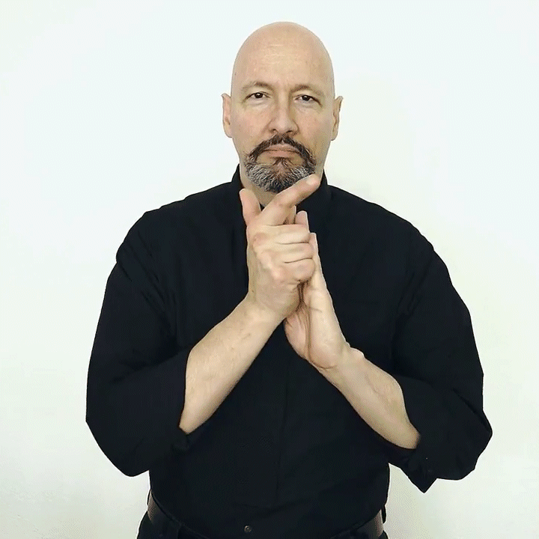
Law
Description: touch an L-handshape to the top of your palm and then the bottom

Slide 18
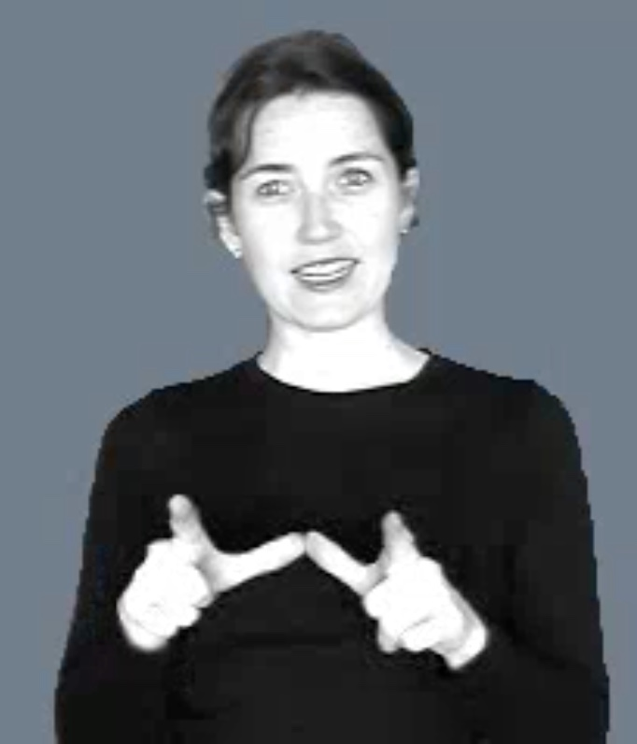
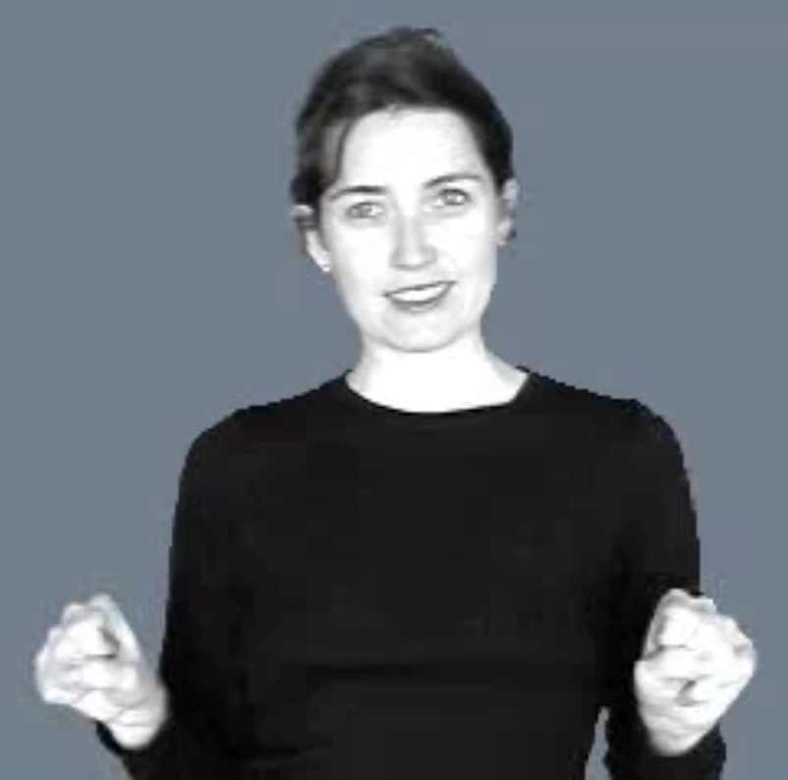
Linguistics
Description: make an L-shape with each hand, put your thumbs together, and then pull them apart into fists

Slide 19
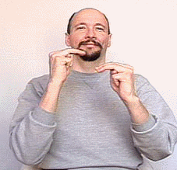
Math
Description: make two M-handshapes and move them across each other

Slide 20
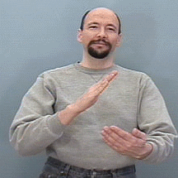
Music
Description: wave your right hand over your left arm like you’re conducting

Slide 21
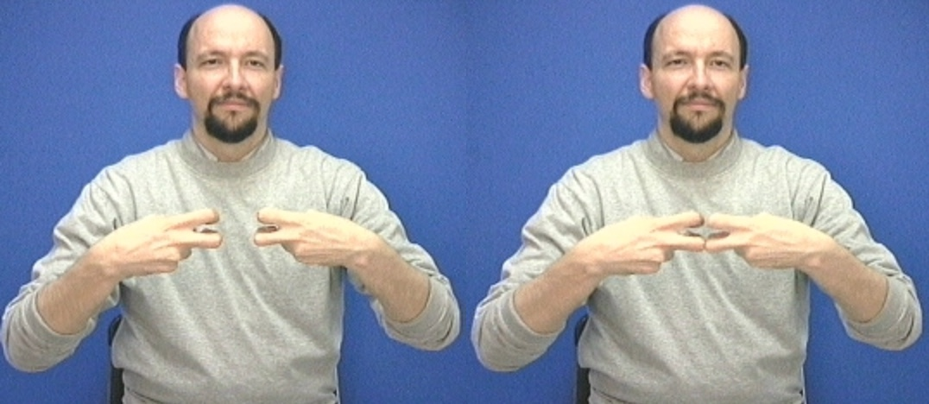
Physics
Description: touch your knuckles together twice

Slide 22
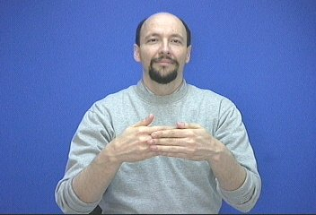
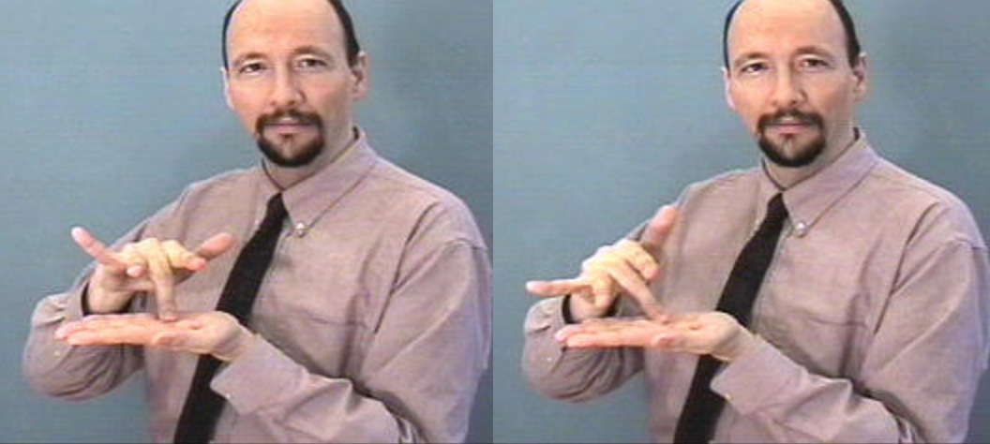
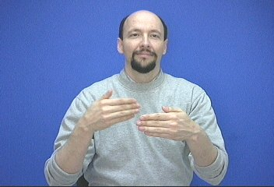
Pre-Med
Before: move your right hand back from your left hand
Medicine: wiggle your right middle finger on your left palm (like a mortar and pestle)

Slide 23
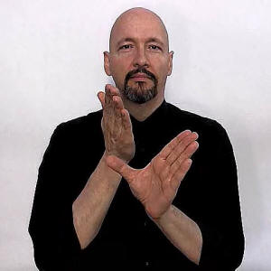
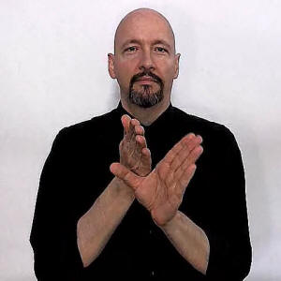
Psychology
Description: tap your right hand by your left thumb twice

Slide 24
Questions?

